Slide 1
UNIT-II Machine Learning

Slide 2
What is Human Learning?
Learning is typically referred to as the process of gaining information through observation.
Why do we need to learn?
In our daily life, we need to carry out multiple activities.
To do a task in a proper way, we need to have prior information on one or more things related to the task.
Also, as we keep learning more or in other words acquiring more information, the efficiency in doing the tasks keep improving.
Thus, with more learning, tasks can be performed more efficiently.

Slide 3
TYPES OF HUMAN LEARNING
Human learning happens in one of the three ways –
(1) either somebody who is an expert in the subject directly teaches us- falls under the category of learning directly under expert guidance
(2) we build our own notion indirectly based on what we have learnt from the expert in the past - falls under learning guided by knowledge gained from experts
(3) we do it ourselves, may be after multiple attempts, some being unsuccessful – falls under learning by self or self learning

Slide 4
1. Learning under expert guidance
In all phases of life of a human being, there is an element of guided learning.
This learning is imparted by someone, purely because of the fact that he/she has already gathered the knowledge by virtue of his/her experience in that field.
So guided learning is the process of gaining information from a person having sufficient knowledge due to the past experience.

Slide 5
2. Learning guided by knowledge gained from experts
An essential part of learning also happens with the knowledge which has been imparted by teacher or mentor at some point of time in some other form/context.
For example, a baby can group together all objects of same color even if his parents have not specifically taught him to do so. He is able to do so because at some point of time or other his parents have told him which color is blue, which is red, which is green, etc
Like this, in all situations, there is no direct learning. It is some past information shared on some different context, which is used as a learning to make decisions.

Slide 6
3. Learning by self
In many situations, humans are left to learn on their own.
A classic example is a baby learning to walk through obstacles. He bumps on to obstacles and falls down multiple times till he learns that whenever there is an obstacle, he needs to cross over it. He faces the same challenge while learning to ride a cycle as a kid or drive a car as an adult.
Not all things are taught by others.
A lot of things need to be learnt only from mistakes made in the past.
We tend to form a check list on things that we should do, and things that we should not do, based on our experiences.

Slide 7
What is Machine Learning?
Before answering the question ‘What is machine learning?’ more fundamental questions that peep into one’s mind are
Do machines really learn?
If so, how do they learn?
Which problem can we consider as a well-posed learning problem?
What are the important features that are required to well-define a learning problem?

Slide 8
Definition
The one which is perhaps most relevant, concise and accepted universally is the one stated by Tom M. Mitchell
‘A computer program is said to learn from experience E with respect to some class of tasks T and performance measure P, if its performance at tasks in T, as measured by P, improves with experience E.’
What this essentially means is that a machine can be considered to learn if it is able to gather experience by doing a certain task and improve its performance in doing the similar tasks in the future. When we talk about past experience, it means past data related to the task. This data is an input to the machine from some source.

Slide 9
Example
In the context of the learning to play checkers,
E represents the experience of playing the game,
T represents the task of playing checkers and
P is the performance measure indicated by the percentage of games won by the player.
The same mapping can be applied for any other machine learning problem,

Slide 10
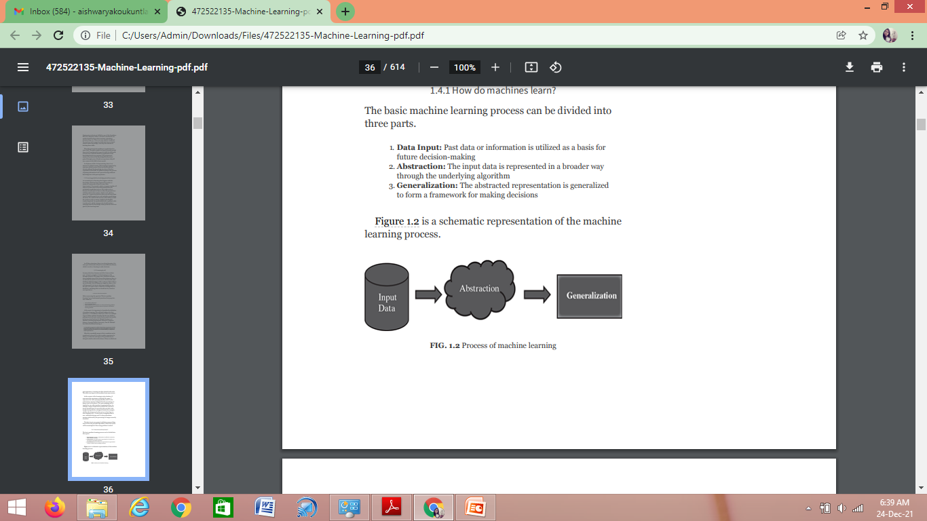
How do machines learn?
The basic machine learning process can be divided into three parts:
1. Data Input: Past data or information is utilized as a basis for future decision-making
2. Abstraction: The input data is represented in a broader way through the underlying algorithm
3. Generalization: The abstracted representation is generalized to form a framework for making decisions

Slide 11
Abstraction
Abstraction helps in deriving a conceptual map based on the input data.
This map, or a model as it is known in the machine learning paradigm, is summarized knowledge representation of the raw data.
The model may be in any one of the following forms:
Computational blocks like if/else rules
Mathematical equations
Specific data structures like trees or graphs
Logical groupings of similar observations
The choice of the model used to solve a specific learning problem is a human task.

Slide 12
The decision related to the choice of model is taken based on multiple aspects, some of which are listed below:
The type of problem to be solved: Whether the problem is related to forecast or prediction, analysis of trend, understanding the different segments or groups of objects, etc.
Nature of the input data: How exhaustive the input data is, whether the data has no values for many fields, the data types, etc.
Domain of the problem: If the problem is in a business critical domain with a high rate of data input and need for immediate inference, e.g. fraud detection problem in banking domain. Once the model is chosen, the next task is to fit the model based on the input data

Slide 13
Let’s understand this with an example.
say ‘y = c + c x’ (the model is known as simple linear regression), based on the input data, we have to find out the values of c and c .
Otherwise, the equation (or the model) is of no use.
So, fitting the model, in this case, means finding the values of the unknown coefficients or constants of the equation or the model.
This process of fitting the model based on the input data is known as training.
Also, the input data based on which the model is being finalized is known as training data.

Slide 14
Generalization
The first part of machine learning process is abstraction i.e. abstract the knowledge which comes as input data in the form of a model.
However, this abstraction process, or more popularly training the model, is just one part of machine learning.
The other key part is to tune up the abstracted knowledge to a form which can be used to take future decisions. This is achieved as a part of generalization. This part is quite difficult to achieve.
This is because the model is trained based on a finite set of data, which may possess a limited set of characteristics.
But when we want to apply the model to take decision on a set of unknown data, usually termed as test data, we may encounter two problems:
1. The trained model is aligned with the training data too much, hence may not portray the actual trend.
2. The test data possess certain characteristics apparently unknown to the training data.

Slide 15
Hence, a precise approach of decision-making will not work. An approximate or heuristic approach, much like gut-feeling-based decision-making in human beings, has to be adopted.
This approach has the risk of not making a correct decision – quite obviously because certain assumptions that are made may not be true in reality.
But just like machines, same mistakes can be made by humans too when a decision is made based on intuition or gut-feeling – in a situation where exact reason-based decision-making is not possible.

Slide 16
Well-posed learning problem
For defining a new problem, which can be solved using machine learning, a simple framework, highlighted below, can be used. This framework also helps in deciding whether the problem is a right candidate to be solved using machine learning.
The framework involves answering three questions:
1. What is the problem?
2. Why does the problem need to be solved?
3. How to solve the problem?

Slide 17
Step 1: What is the problem?
Describe the problem informally and formally and list assumptions and similar problems.
Step 2: Why does the problem need to be solved?
List the motivation for solving the problem, the benefits that the solution will provide and how the solution will be used.
Step 3: How would I solve the problem?
Describe how the problem would be solved manually to flush domain knowledge.

Slide 18
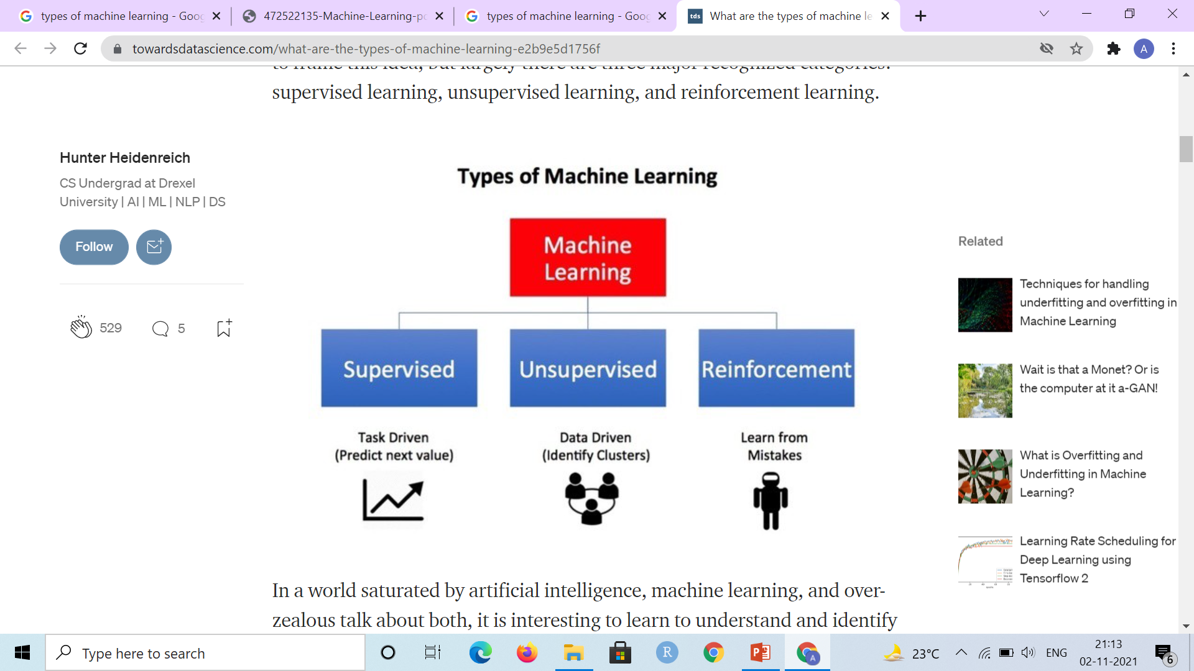
Types of Machine Learning

Slide 19
Machine learning can be classified into three broad categories:
1. Supervised learning – Also called predictive learning. A machine predicts the class of unknown objects based on prior class related information of similar objects.
2. Unsupervised learning – Also called descriptive learning. A machine finds patterns in unknown objects by grouping similar objects together.
3. Reinforcement learning – A machine learns to act on its own to achieve the given goals.

Slide 20
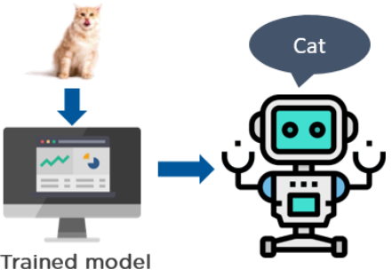
Supervised Learning
Supervised learning is a type of machine learning that uses labeled data to train machine learning models. In labeled data, the output is already known. The model just needs to map the inputs to the respective outputs.
An example of supervised learning
is to train a system that identifies
the image of an animal.
You can see that we have our trained
model that identifies the picture of a cat.

Slide 21
Working:
Supervised learning algorithms take labeled inputs and map them to the known outputs, which means you already know the target variable.
Now, let’s focus on the training process for the supervised learning method.
Supervised Learning methods need external supervision to train machine learning models. Hence, the name supervised. They need guidance and additional information to return the desired result.
Supervised learning algorithms are generally used for solving classification and regression problems.
Few of the top supervised learning applications are weather prediction, sales forecasting, stock price analysis.

Slide 22
a) Classification
Classification algorithms are used to solve the classification problems in which the output variable is categorical, such as "Yes" or No, Male or Female, Red or Blue, etc. The classification algorithms predict the categories present in the dataset. Some real-world examples of classification algorithms are Spam Detection, Email filtering, etc.
b) Regression
Regression algorithms are used to solve regression problems in which there is a linear relationship between input and output variables. These are used to predict continuous output variables, such as market trends, weather prediction, etc.

Slide 23
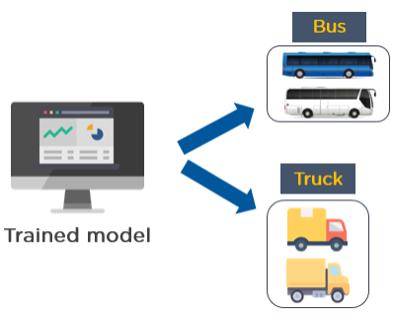
Unsupervised Learning
Unsupervised learning is a type of machine learning that uses unlabeled data to train machines. Unlabeled data doesn’t have a fixed output variable. The model learns from the data, discovers the patterns and features in the data, and returns the output.
Example of an unsupervised learning technique that uses the images of vehicles to classify if it’s a bus or a truck.
The model learns by identifying the parts of a vehicle, such as a length and width of the vehicle, the front, and rear end covers, roof hoods, the types of wheels used, etc.
Based on these features, the model classifies if the vehicle is a bus or a truck.

Slide 24
Working:
Unsupervised learning finds patterns and understands the trends in the data to discover the output. So, the model tries to label the data based on the features of the input data.
The training process used in unsupervised learning techniques does not need any supervision to build models. They learn on their own and predict the output.
Unsupervised learning is used for solving clustering and association problems.
One of the applications of unsupervised learning is customer segmentation. Based on customer behavior, likes, dislikes, and interests, you can segment and cluster similar customers into a group.

Slide 25
1) Clustering
The clustering technique is used when we want to find the inherent groups from the data. It is a way to group the objects into a cluster such that the objects with the most similarities remain in one group and have fewer or no similarities with the objects of other groups. An example of the clustering algorithm is grouping the customers by their purchasing behaviour.
2) Association
Association rule learning is an unsupervised learning technique, which finds interesting relations among variables within a large dataset. The main aim of this learning algorithm is to find the dependency of one data item on another data item and map those variables accordingly so that it can generate maximum profit. This algorithm is mainly applied in Market Basket analysis, Web usage mining, continuous production, etc.

